Slide 1

WELCOME
TO THE
CTD COMMISSION MEETING
JUNE 3, 2020

Slide 2
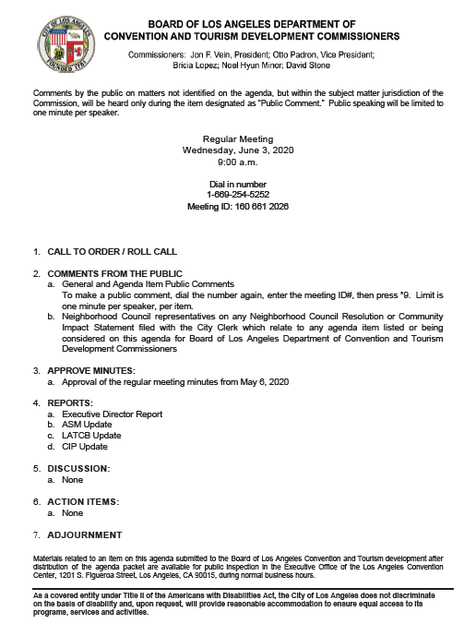
1

Slide 3

EXECUTIVE DIRECTOR REPORT
2

Slide 4
3

Slide 5
4

Slide 6
5

Slide 7
6

Slide 8
7

Slide 9
8

Slide 10
9

Slide 11
10

Slide 12
11

Slide 13
CTD BOARD OF COMMISSIONERS MEETING
June 3, 2020

Slide 14
CITYWIDE CONVENTION SALES
YTD FY19/20 PRODUCTION RESULTS
Lead Production | Leads Actual
FY 19/20 Goal | 220
FY 19/20 YTD | 153
FY 18/19 STLY | 204
Booked Room Nights Produced | RNs Actual
FY 19/20 Goal | 390,000
FY 19/20 YTD | 322,531
FY 18/19 STLY | 301,131
Dated May 26, 2020
13

Slide 15
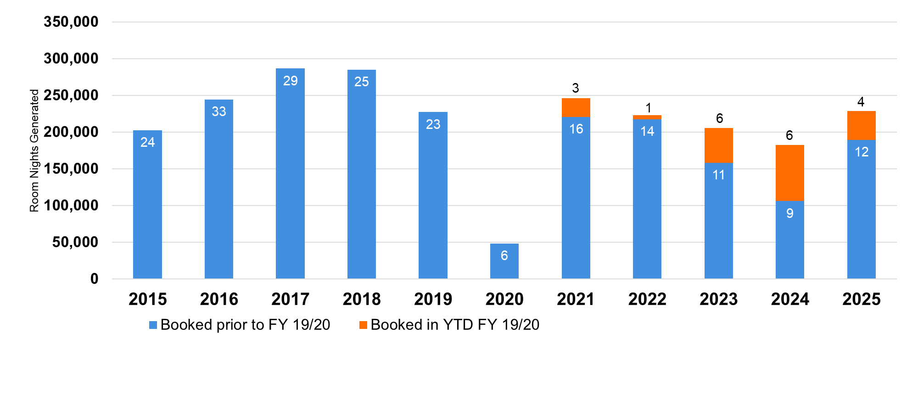
CITYWIDE CONVENTION BOOKED ROOM NIGHTS
2015-2025 CALENDAR YEAR ARRIVAL DATE
Dated May 26, 2020
14

Slide 16



ADOBE & GSMA UPDATES
2020: Virtual
2021: Las Vegas
2022 – 2025: Los Angeles LOI's Signed
2026 – 2030: Los Angeles LOI’s Pending
2020: Cancelled (L.A., Barcelona & Shanghai)
2021: Looking to License Los Angeles
2022 – 2025: Los Angeles LOI's Pending
15

Slide 17
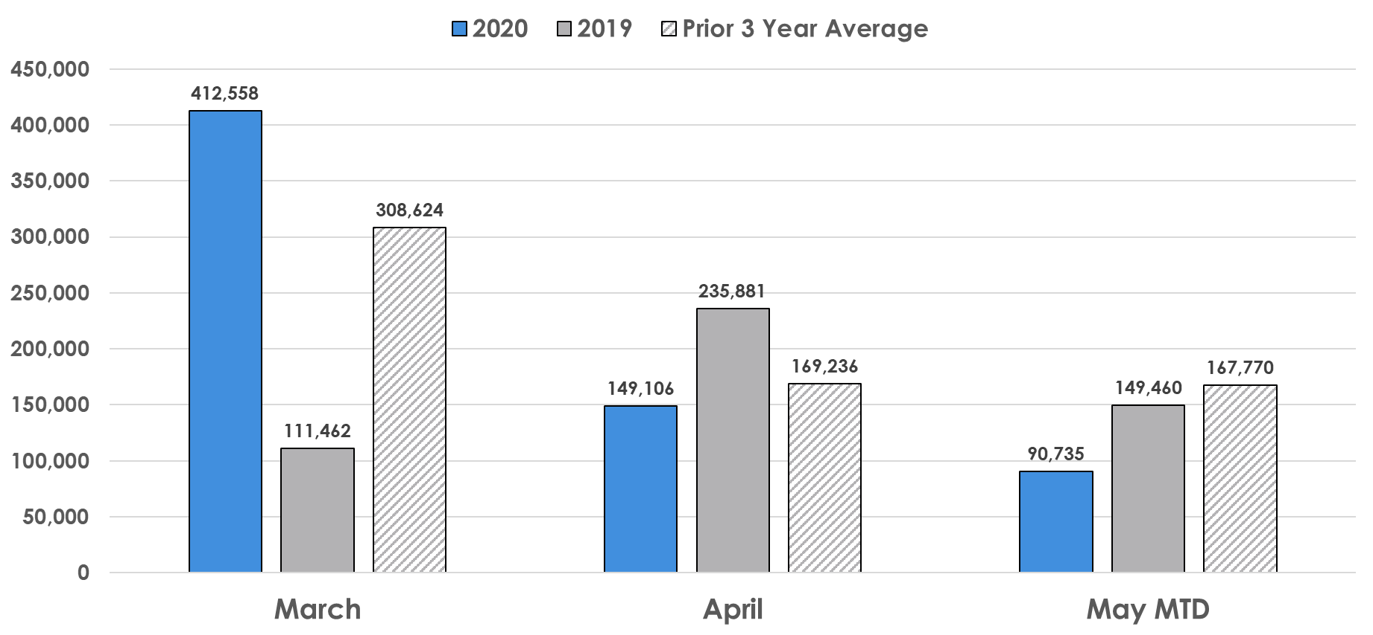
CITYWIDE SALES LEAD ROOMNIGHTS
16
May 26, 2020

Slide 18




MEETING & EVENTS POST COVID-19 HEALTH & SAFETY PROTOCOLS
SALES PLANNING
  Virtual site visit capabilities
  Hotel/Venue Health and Safety Guidelines/Protocols
  Emergency Action Plan (during event/meeting)
  Utilizing open air/well ventilated spaces
TRAVEL PROCEDURES
  Airport experience
  Mass transportation
  Shared ride services
REGISTRATION
  Contact‐less Registration
  Temperature check points/Thermal cameras
PUBLIC SPACES
  Security Staffing
  Enhanced signage on physical distancing & safety protocols
  Sanitation stations
  Space between exhibit booths – positioning of foot traffic, monitoring entrance to exhibit hall
  Booth staffing allowance based on square footage
  Cleaning/Sanitation protocols
FACILITIES
  Meeting room layout to adhere to physical distancing requirements
  Cleaning/Sanitation protocols
FOOD AND BEVERAGE SERVICE
  Elimination of Buffets
  Banquet sets to adhere to physical distancing requirements
  Beverage Stations monitors
  Banquet service plan
  Banquet Staff to be masked and gloved
  Pre-packaged food and individually wrapped condiments
  Cleaning/Sanitation protocols
BACK OF HOUSE PROCEDURES
  Staffing protocols
  Storage and Sanitation of equipment
17

Slide 19
FIELD FINDINGS-HOTELS
From direct contact with hotel partners, corporate directives are:
  Marriott – Forthcoming - JW comprehensive property-level efforts in place
  Hilton – Forthcoming
  IHG - InterCon – Forthcoming – DTLA in progress with property-level guideline
  Loews – Forthcoming – HW property-level guidelines in place
18

Slide 20
HEALTH SAFETY & CLEANING INITIATIVES (SKIFT)
Company | Initiative | Guidelines
Marriott | Marriott Global Cleanliness Council | Commitment to Clean
Hilton | Hilton CleanStay | New Standard of Cleanliness
Accor | ALLSAFE | The ALLSAFE Label Framework
IHG | IHG Clean Promise | IHG Way of Clean Enhancements
Hyatt | Global Care & Cleanliness Commitment | Global Cleanliness Accreditation
Omni | Omni Safe & Clean | Stay A Part of Safety
Four Seasons | Lead With Care | Global Program Guidance
Wyndham | Count On Us | Health & Safety Protocols
Choice Hotels | Commitment to Clean | Protocols and Products
Best Western | We Care Clean | Five Key Areas
Loews Hotels | Safety & Well-Being Protocols | Service Promise and Protocols
Airbnb | Enhanced Cleaning Initiative | ECI Teaser
VRBO | Enhanced Cleaning and Disinfection of Vacation Rentals | New Vacation Rental Standards
Red Roof Inn | Red Roof RediClean | Protocols for Employees and Cleaning
Extended Stay America | STAY Confident | Stay Safe, Stay Healthy, Stay Comfortable
American Hotel & Lodging Association | Safe Stay | Safe Stay Guidelines
19

Slide 21
TRAVEL INDUSTRY RECOVERY GUIDELINES (SKIFT)
Segment | Association | Guidelines
Nine Sectors Worldwide | World Travel & Tourism Council (WTTC) | Safe Travels: Global Protocols for the New Normal
U.S. Airlines | Airlines for America (A4A) | Covid-19 Resources for Airlines
U.S. Hotels | American Hotel & Lodging Association (AHLA) | Safe Stay Guidelines
U.S. Vacation Rentals | Vacation Rental Management Association (VRMA) | Safe Home Guidelines
Short-Term Rentals | Airbnb | Enhanced Cleaning Initiative
Attractions Worldwide | International Association of Amusement Parks and Attractions (IAAPA) | Reopening Guidance
Cruises Worldwide | Cruise Lines International Association (CLIA) | Covid-19 Toolkit for Cruise Industry
Europe | European Commission | Commission’s Guidance on How to Safely Resume Travel and Reboot Europe’s Tourism in 2020 and Beyond
U.S. Tourism | U.S. Travel Association | Health and Safety Guidance
China | McKinsey | What the World Can Learn from China’s Travel Restart
Singapore | Singapore Tourism Board | Singapore’s Clean Tourism Initiative
Restaurants | National Restaurants Association | U.S. Restaurants Reopening Guide
Spas Worldwide | International Spa Association | Reopening Resources for Spas
U.S. Recreation | Outdoor Recreation Roundtable (ORR) | Reopening Strategy
U.S. National Parks | National Park Service | Public Health Update
U.S. Museums | American Alliance of Museums | Preparing to Reopen
U.S. Federal Guidance on Cleaning in the Coronavirus Era | Occupational Safety and Health Administration | Guidance on Preparing Workplaces for Covid-19
20

Slide 22
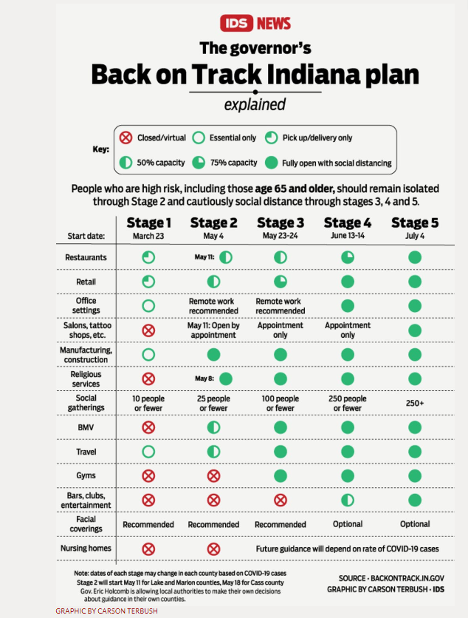
21
https://www.idsnews.com/article/2020/05/coronavirus-indiana-holcomb-to-reopen-bars-restaurants-economy

Slide 23
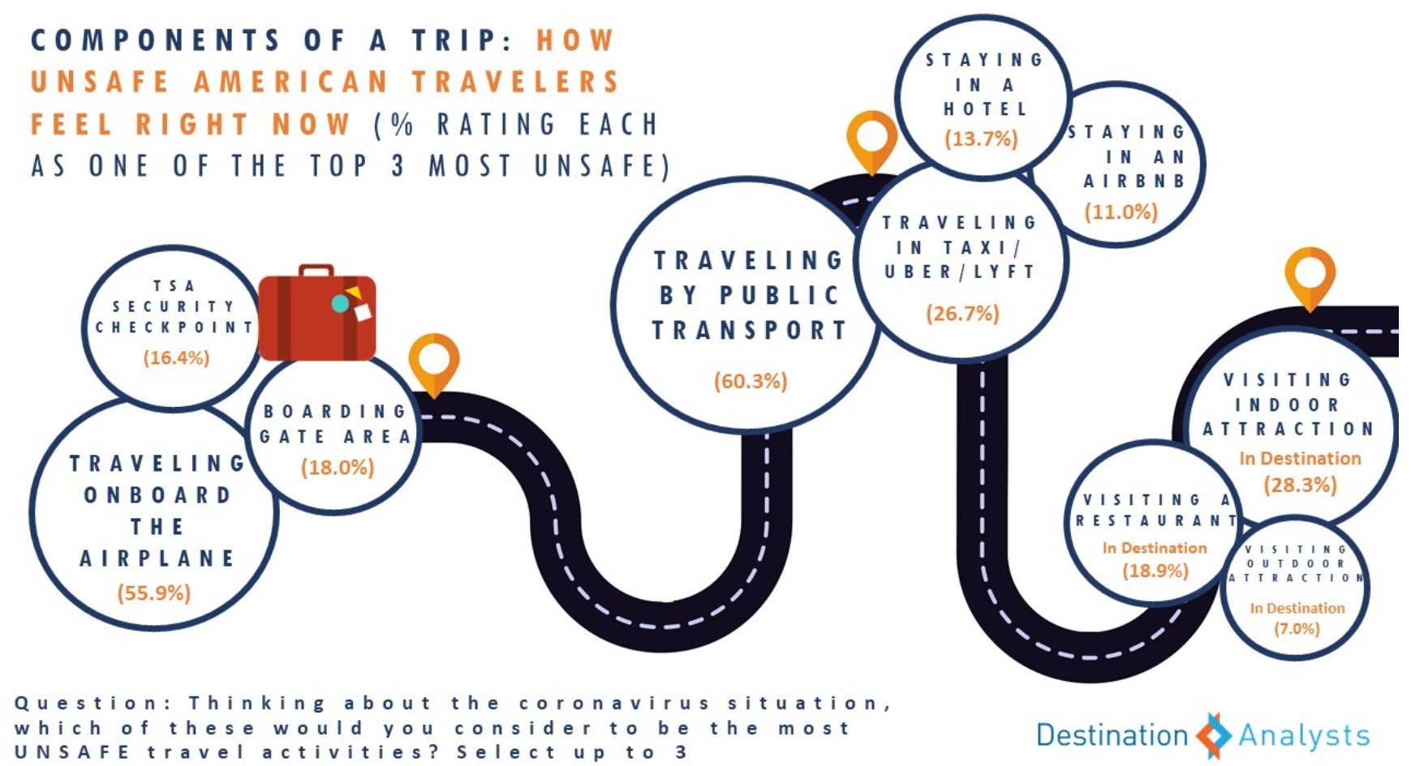
22

Slide 24
THANK YOU

Slide 25

24

Slide 26
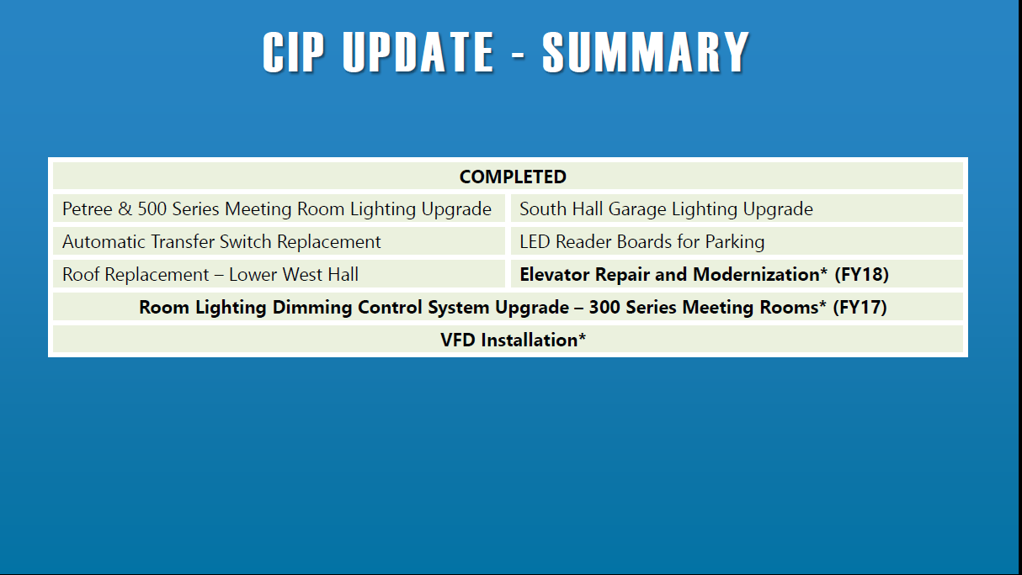
25

Slide 27
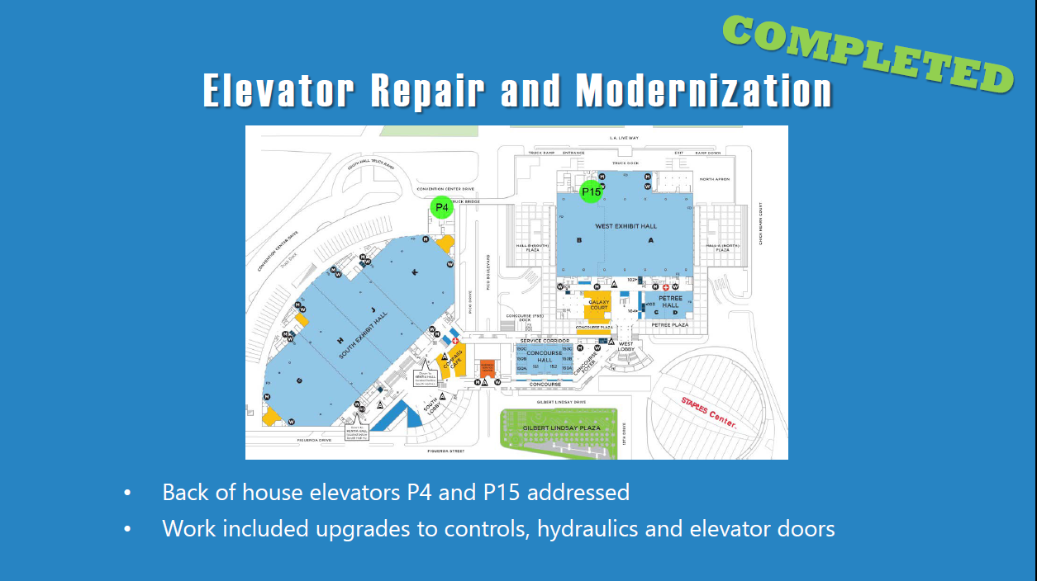
26

Slide 28
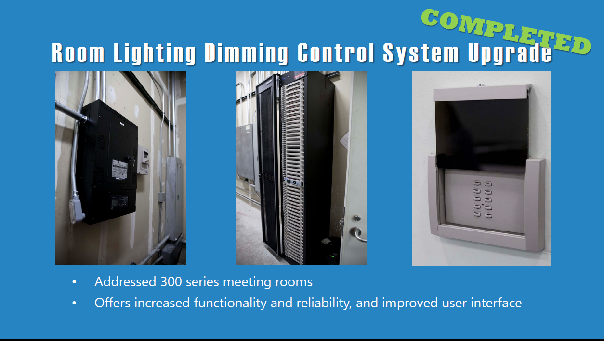
27

Slide 29
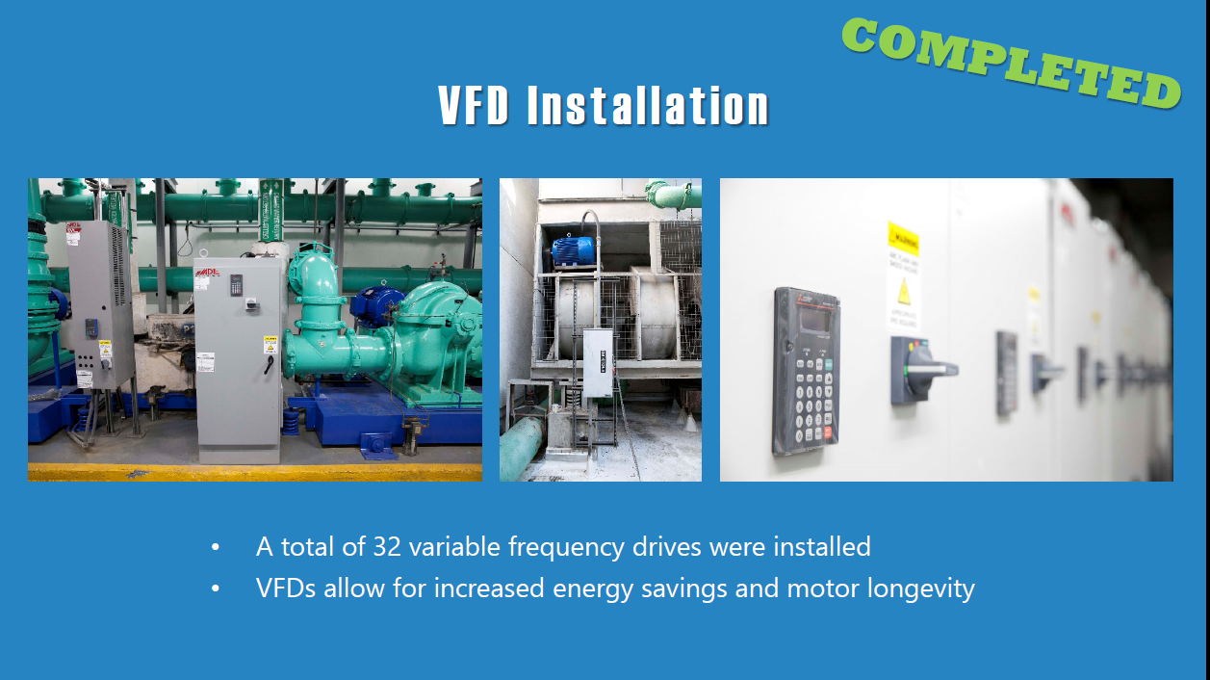
28

Slide 30
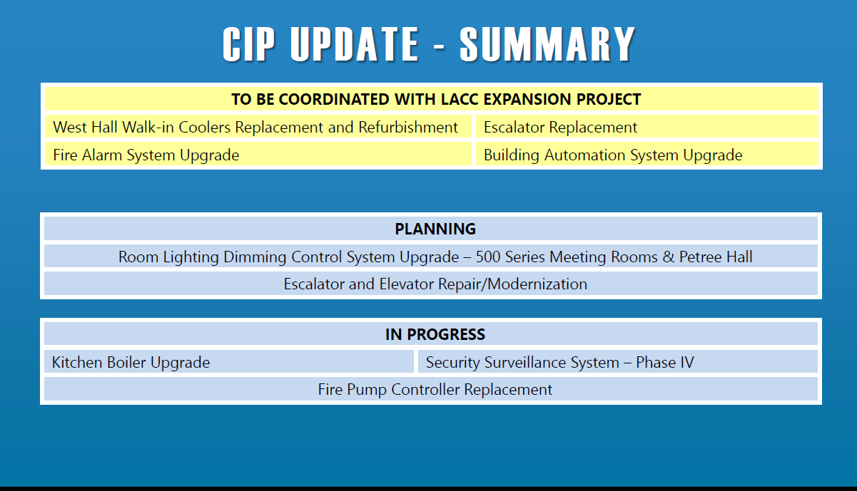
29

Slide 31
30

